Slide 1





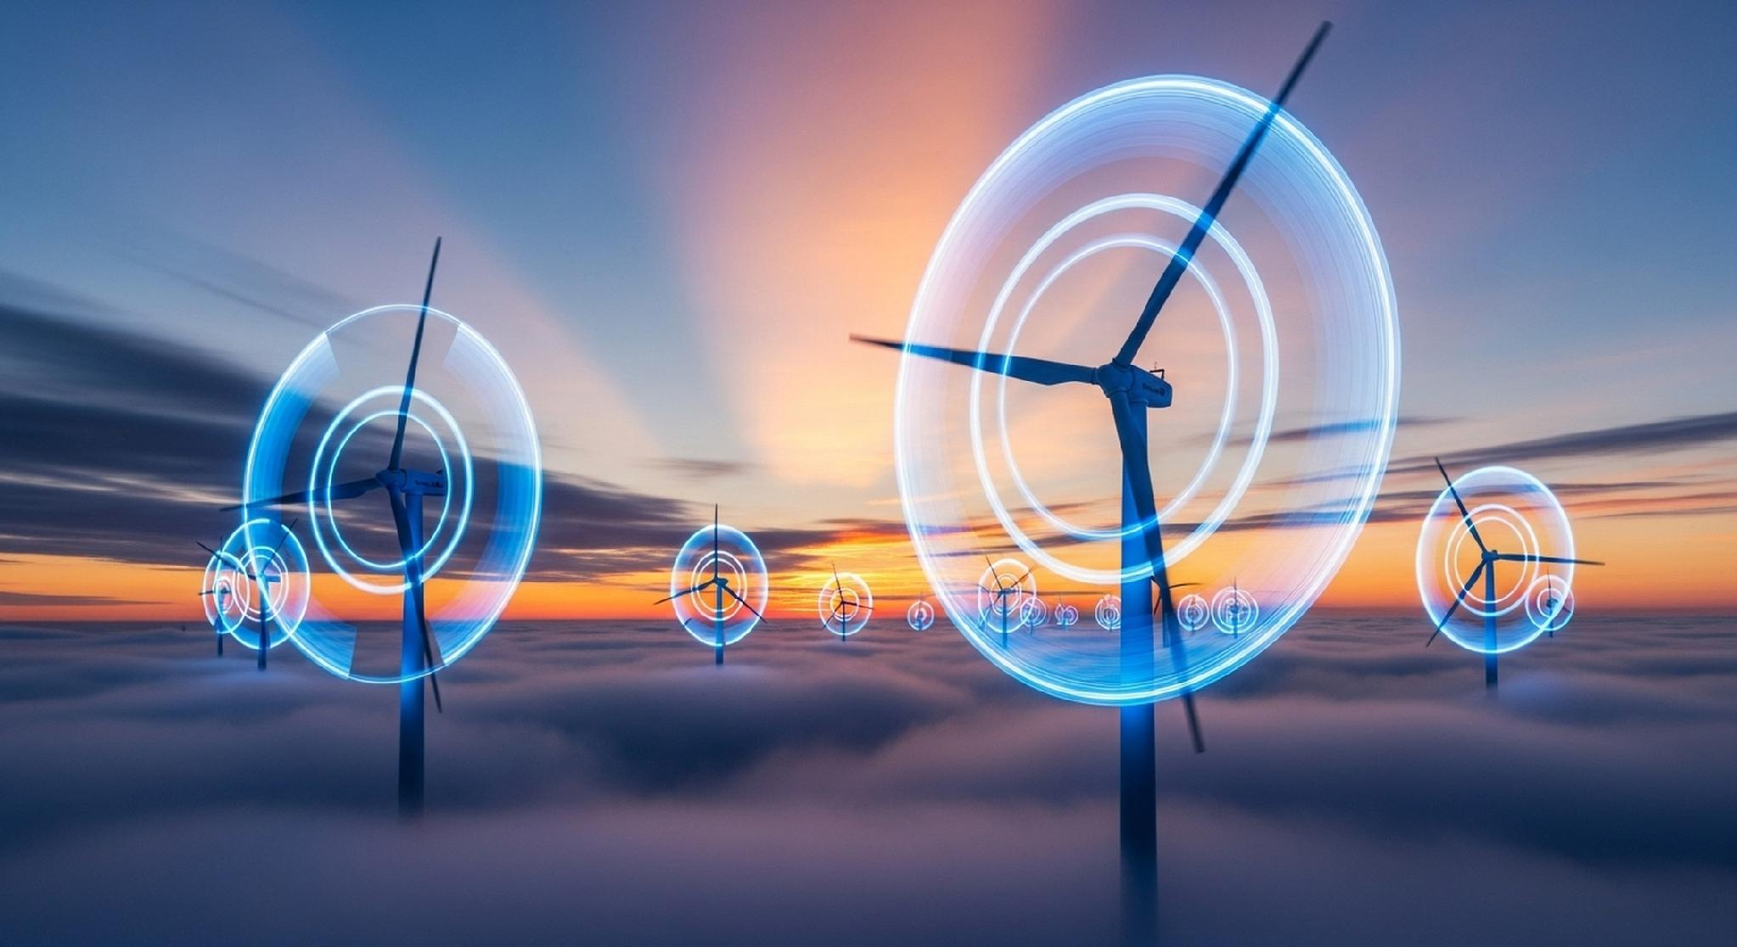


3D-CIRCULAR
3 NEW MASTER PROGRAMMES IN
DIGITAL DEEP TECH DRIVEN CIRCULAR ECONOMY
M.Sc. · M.Sc. By Research · MBA
This project has received funding from the European Health and Digital Executive Agency under the Grant Agreement No 101226256. Views and opinions expressed are however those of the author(s) only and do not necessarily reflect those of the European Union or the European Health and Digital Executive Agency (HaDEA). Neither the European Union nor the granting authority can be held responsible for them.

Slide 2


3D-CIRCULAR
Project Title: Digital Deep tech Driven Circular Economy
Project Acronym: 3D-CIRCULAR
Project Number: 101226256
Start Date: 1/8/2025 (48 months)
32 partners from 14 countries
Coordinator: University of the Aegean
This project has received funding from the European Health and Digital Executive Agency under the Grant Agreement No 101226256. Views and opinions expressed are however those of the author(s) only and do not necessarily reflect those of the European Union or the European Health and Digital Executive Agency (HaDEA). Neither the European Union nor the granting authority can be held responsible for them.

Slide 3
+
Master Programmes
MSc
MBA
Master of Science (MSc) in Digital Deep Tech Driven Circular Economy
Master of Business Administration (MBA) in Digital Deep Tech Driven Circular Economy
Focusing on the technical, analytical, and innovation aspects of circular economy, using deep technologies such as AI, blockchain, IoT, and digital twins.
MScRes
Focusing on leadership, management, and business strategy aspects, with an emphasis on applying deep technologies for circular economy initiatives.​
Master of Science by Research (MScRes) in Digital Deep Tech Driven Circular Economy
Focusing In exercising the capabilities for applied research in the use of digital deep tech technologies for sustainable development through circular economy.​
This project has received funding from the European Health and Digital Executive Agency under the Grant Agreement No 101226256. Views and opinions expressed are however those of the author(s) only and do not necessarily reflect those of the European Union or the European Health and Digital Executive Agency (HaDEA). Neither the European Union nor the granting authority can be held responsible for them.

Slide 4
M.Sc. in Digital Deep-Tech Driven Circular Economy
Applied postgraduate pathway for digital and green transformation skills.
Designed for graduates and professionals who want to combine
advanced digital technologies with circular economy principles
and practical transformation skills.​
DURATION
CREDITS
DELIVERY
AWARD
3 semesters
90 ECTS
Online
M.Sc.
Focus
Best fit
Outcome
Applied digital circular economy, product lifecycle monitoring, DPPs, AI, blockchain and data-driven solutions.​
Graduates, engineers, sustainability, digital transformation, operations, policy and innovation profiles.​
A final postgraduate thesis connected to a digital circular economy challenge.​
This project has received funding from the European Health and Digital Executive Agency under the Grant Agreement No 101226256. Views and opinions expressed are however those of the author(s) only and do not necessarily reflect those of the European Union or the European Health and Digital Executive Agency (HaDEA). Neither the European Union nor the granting authority can be held responsible for them.

Slide 5
Master of Science in Digital Deep-Tech Driven Circular Economy
SEMESTER 1
SEMESTER 2
1
Introduction to Digital Circular Economy
1
Blockchain Technologies for Circular Ecosystems
6 ECTS
Obligatory
8 ECTS
Obligatory
2
Data Analytics and Lifecycle Assessment in Circular Economy
6 ECTS
Obligatory
2
Circular Economy and Digital Product Passports
8 ECTS
Obligatory
3
Deep-Tech Driven Energy Transformation
6 ECTS
Elective
3
Standardisation and EU Regulatory Compliance in Digital Circular Economy
8 ECTS
Obligatory
4
Circular Economy and Digital Health
6 ECTS
Elective
4
Artificial Intelligence and Robotics in Circular Economy Ecosystems
Obligatory
5
Sustainable Manufacturing and Industry 4.0
6 ECTS
Elective
6 ECTS
6
AI and Blockchain for Circular Supply Chain Management
6 ECTS
Elective
7
Smart, Circular and Resilient Cities and Regions
6 ECTS
Elective
SEMESTER 3
8
Data-driven Circular Economy for Social Economy
6 ECTS
Elective
9
International Conference/Bootcamp on Digital Deep tech Driven Circular Economy
1
Obligatory
6 ECTS
Elective
MSc Thesis
30 ECTS
This project has received funding from the European Health and Digital Executive Agency under the Grant Agreement No 101226256. Views and opinions expressed are however those of the author(s) only and do not necessarily reflect those of the European Union or the European Health and Digital Executive Agency (HaDEA). Neither the European Union nor the granting authority can be held responsible for them.

Slide 6
M.Sc. by Research in Digital Deep-Tech Driven Circular Economy
Applied postgraduate pathway for digital and green transformation skills.​
Designed around inquiry, research methods, proposal development and supervised thesis work, with a strong connection to European innovation and research cosystems.
DURATION
CREDITS
DELIVERY
AWARD
3 semesters
90 ECTS
Online
MScRes
Focus
Best fit
Outcome
Applied research in digital deep tech, circular
systems, lifecycle data and sustainability challenges.​
Research-oriented graduates, future PhD candidates, technical researchers, policy and innovation professionals.​
Supervised research thesis with research output and proposal development components.​
This project has received funding from the European Health and Digital Executive Agency under the Grant Agreement No 101226256. Views and opinions expressed are however those of the author(s) only and do not necessarily reflect those of the European Union or the European Health and Digital Executive Agency (HaDEA). Neither the European Union nor the granting authority can be held responsible for them.

Slide 7
Master of Science by research in Digital Deep-Tech Driven Circular Economy
SEMESTER 1
SEMESTER 2
1
Introduction to Digital Circular Economy
8 ECTS
Obligatory
1
Research Methodology
12 ECTS
Obligatory
2
EU Research Funding & Proposal Development
12 ECTS
Obligatory
2
Circular Economy and Digital Product Passports
8 ECTS
Obligatory
3
Deep-Tech Driven Energy Transformation
6 ECTS
Elective
3
Standardisation and EU Regulatory Compliance in Digital Circular Economy
8 ECTS
Obligatory
4
Circular Economy and Digital Health
6 ECTS
Elective
4
Artificial Intelligence and Robotics in Circular Economy Ecosystems
Obligatory
5
Sustainable Manufacturing and Industry 4.0
6 ECTS
Elective
6 ECTS
6
AI and Blockchain for Circular Supply Chain Management
6 ECTS
Elective
7
Smart, Circular and Resilient Cities and Regions
6 ECTS
Elective
SEMESTER 3
8
Data-driven Circular Economy for Social Economy
6 ECTS
Elective
9
International Conference/Bootcamp on Digital Deep tech Driven Circular Economy
1
Obligatory
6 ECTS
Elective
MSc Thesis
30 ECTS
This project has received funding from the European Health and Digital Executive Agency under the Grant Agreement No 101226256. Views and opinions expressed are however those of the author(s) only and do not necessarily reflect those of the European Union or the European Health and Digital Executive Agency (HaDEA). Neither the European Union nor the granting authority can be held responsible for them.

Slide 8
MBA in Digital Deep-Tech Driven Circular Economy
Executive pathway for leading circular transformation in organisations.
Designed for professionals who want to connect business strategy, innovation, finance, regulation and advanced digital technologies to circular transformation.
DURATION
CREDITS
DELIVERY
AWARD
18 months
90 ECTS
Online with
hybrid elements
MBA Degree
Focus
Best fit
Outcome
Circular business models, digital product data, finance, strategy and organisational transformation.​
Experienced professionals in ESG, operations,
innovation, digital transformation, consultancy and leadership.​
Integrative Business Project translating learning into a practical organisational transformation contribution.​
This project has received funding from the European Health and Digital Executive Agency under the Grant Agreement No 101226256. Views and opinions expressed are however those of the author(s) only and do not necessarily reflect those of the European Union or the European Health and Digital Executive Agency (HaDEA). Neither the European Union nor the granting authority can be held responsible for them.

Slide 9
Master of Business Administration in Digital Deep-Tech Driven Circular Economy
SEMESTER 1
SEMESTER 2
1
MC1 - Introduction to Digital Circular Economy
8 ECTS
1
BC2 - Innovation and Strategic Management in Circular Economy
6 ECTS
Obligatory
Obligatory
2
BC3 - Financial Strategies for Circular Economy Ventures
6 ECTS
Obligatory
2
MC2- Circular Economy and Digital Product Passports
8 ECTS
Obligatory
3
EC1 - Deep-Tech Driven Energy Transformation
6 ECTS
Elective
3
MC3 - Standardisation and EU Regulatory Compliance in Digital Circular Economy
EC2 - Circular Economy and Digital Health
8 ECTS
Obligatory
4
6 ECTS
Elective
4
BC1 - Business Models for Digital Circular Economy
Obligatory
5
EC3 - Sustainable Manufacturing and Industry 4.0
6 ECTS
Elective
6 ECTS
6
EC4 - AI and Blockchain for Circular Supply Chain Management
6 ECTS
Elective
7
EC5 - Smart, Circular and Resilient Cities and Regions
6 ECTS
Elective
SEMESTER 3
8
EC6 - Data-driven Circular Economy for Social Economy
6 ECTS
Elective
9
EC7 - International Conference/Bootcamp on Digital Deep Tech-Driven Circular Economy
1
Obligatory
6 ECTS
Elective
MSc Thesis
30 ECTS
This project has received funding from the European Health and Digital Executive Agency under the Grant Agreement No 101226256. Views and opinions expressed are however those of the author(s) only and do not necessarily reflect those of the European Union or the European Health and Digital Executive Agency (HaDEA). Neither the European Union nor the granting authority can be held responsible for them.

Slide 10

Admissions and eligibility
Key application points for communication material.
Application
Study format
EU / DEP Tuition-free
Expression of Interest is open. All applicants pay a 100€ non-refundable application fee at submission (Platform administrator overhead).
100% online. 90 ECTS.
3 semesters. English.
Planned start date:
October 2026.
Eligible EU and DEP applicants will be exempt from tuition fees.
EXPRESS
YOUR
INTEREST!
3d-circular.eu
M.Sc. & M.Sc. by Research
MBA fees
Start
Application fee: €100.
(Platform administrator overhead).
Admission fee: €500.
Non-EU / non-DEP tuition fee: €5,000.
Application fee: €100.
(Platform administrator overhead).
Admission fee: €2,400.
Non-EU / non-DEP tuition fee: €45,000.
October 2026 intake planned for the master programmes.
This project has received funding from the European Health and Digital Executive Agency under the Grant Agreement No 101226256. Views and opinions expressed are however those of the author(s) only and do not necessarily reflect those of the European Union or the European Health and Digital Executive Agency (HaDEA). Neither the European Union nor the granting authority can be held responsible for them.

Slide 11







Updates
Get Involved
  Follow our updates and open calls
  Engage through pilot courses and certifications
  Partner with us to scale innovation and skills
@3d-circular
@3d_circular
@3D Circular
https://3d-circular.eu/
@3d_circular
@3D_Circular
@3D-CIRCULAR
This project has received funding from the European Health and Digital Executive Agency under the Grant Agreement No 101226256. Views and opinions expressed are however those of the author(s) only and do not necessarily reflect those of the European Union or the European Health and Digital Executive Agency (HaDEA). Neither the European Union nor the granting authority can be held responsible for them.

Slide 12


THANK YOU
FOR YOUR NICE ATTENTION
This project has received funding from the European Health and Digital Executive Agency under the Grant Agreement No 101226256. Views and opinions expressed are however those of the author(s) only and do not necessarily reflect those of the European Union or the European Health and Digital Executive Agency (HaDEA). Neither the European Union nor the granting authority can be held responsible for them.

